Slide 1





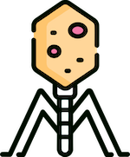




MATHEMATICALLY MODELING THE INTERACTIONS BETWEEN PHAGES, BACTERIA, RESOURCES, AND THE ENVIRONMENT
VICTOR PIASKOWSKI
UNIVERSITY OF AMSTERDAM
VRIJE UNIVERSITEIT AMSTERDAM
DR. MATTI GRALKA
Notes:
Hello welcome to my thesis defense for my masters and sciences. My name is Victor and I will be talking about.

Slide 2
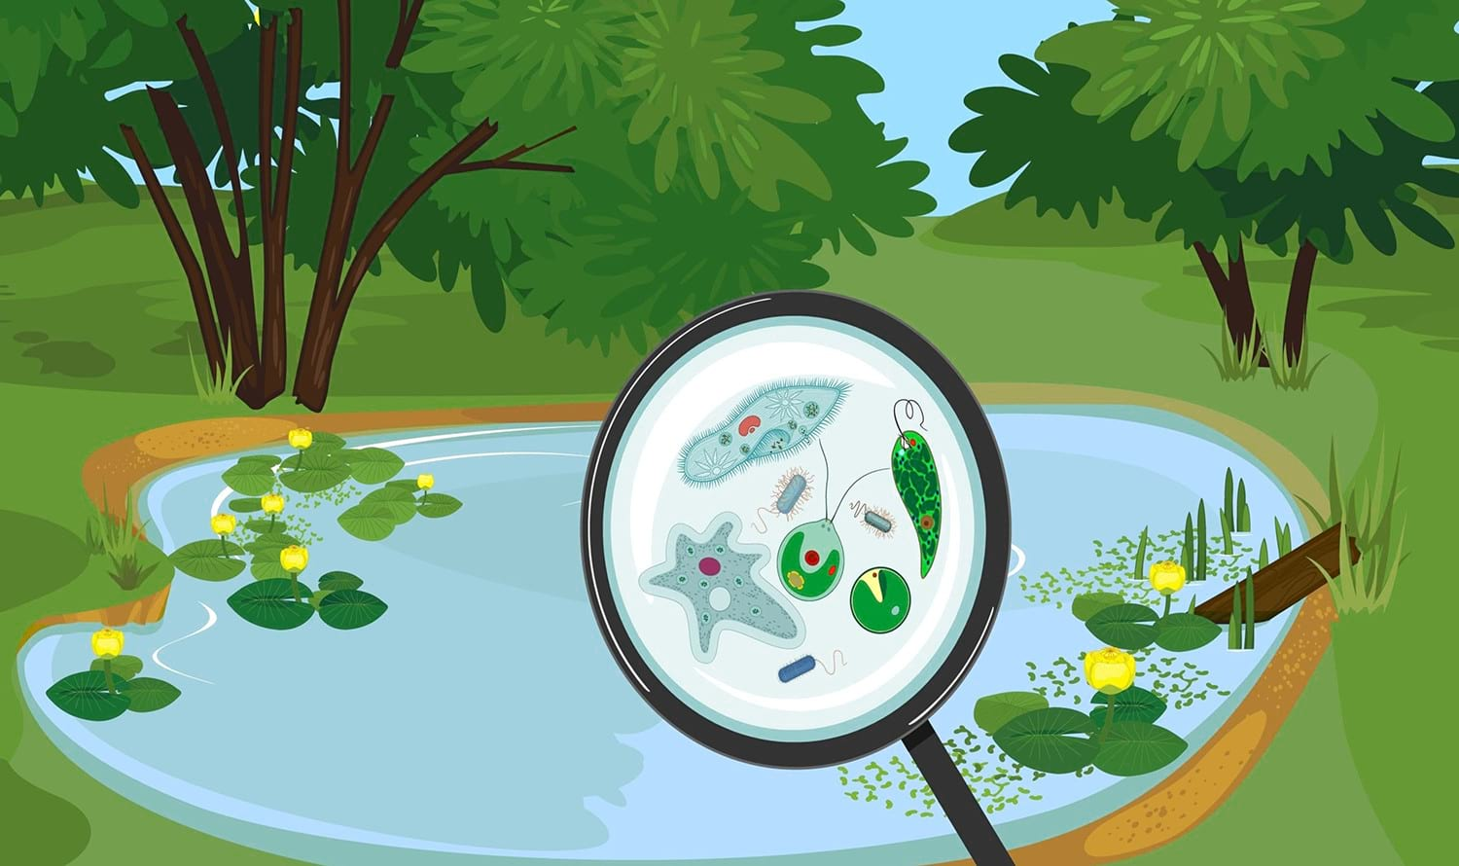


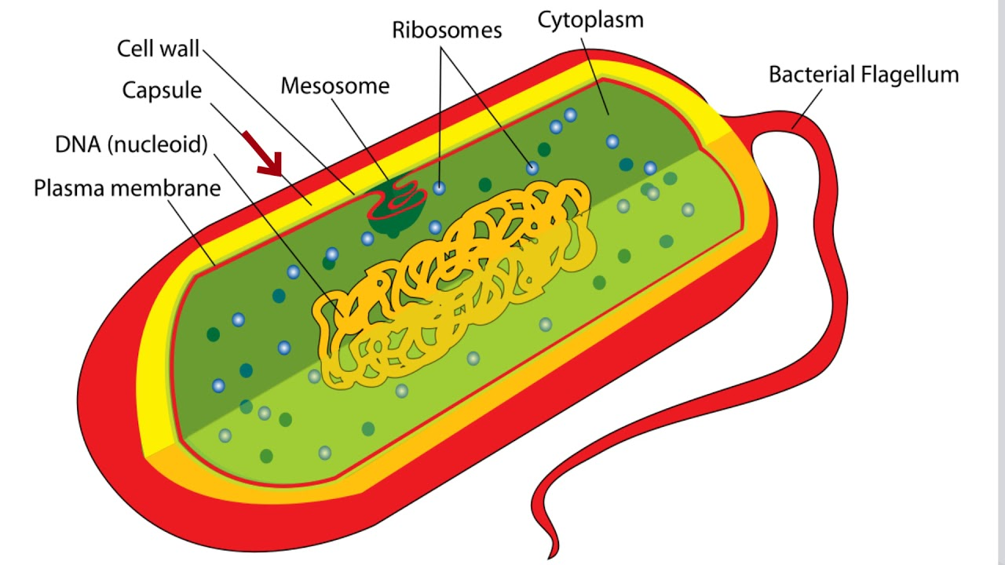

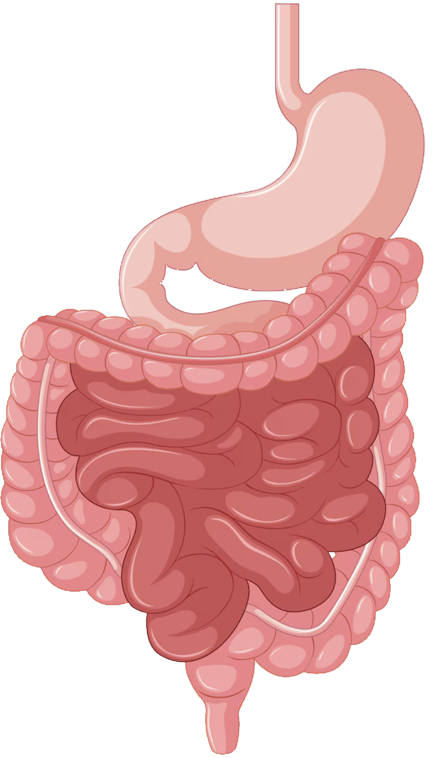
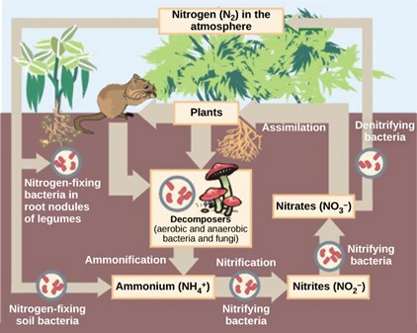
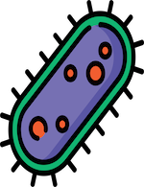

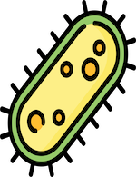


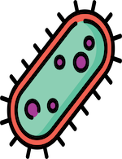
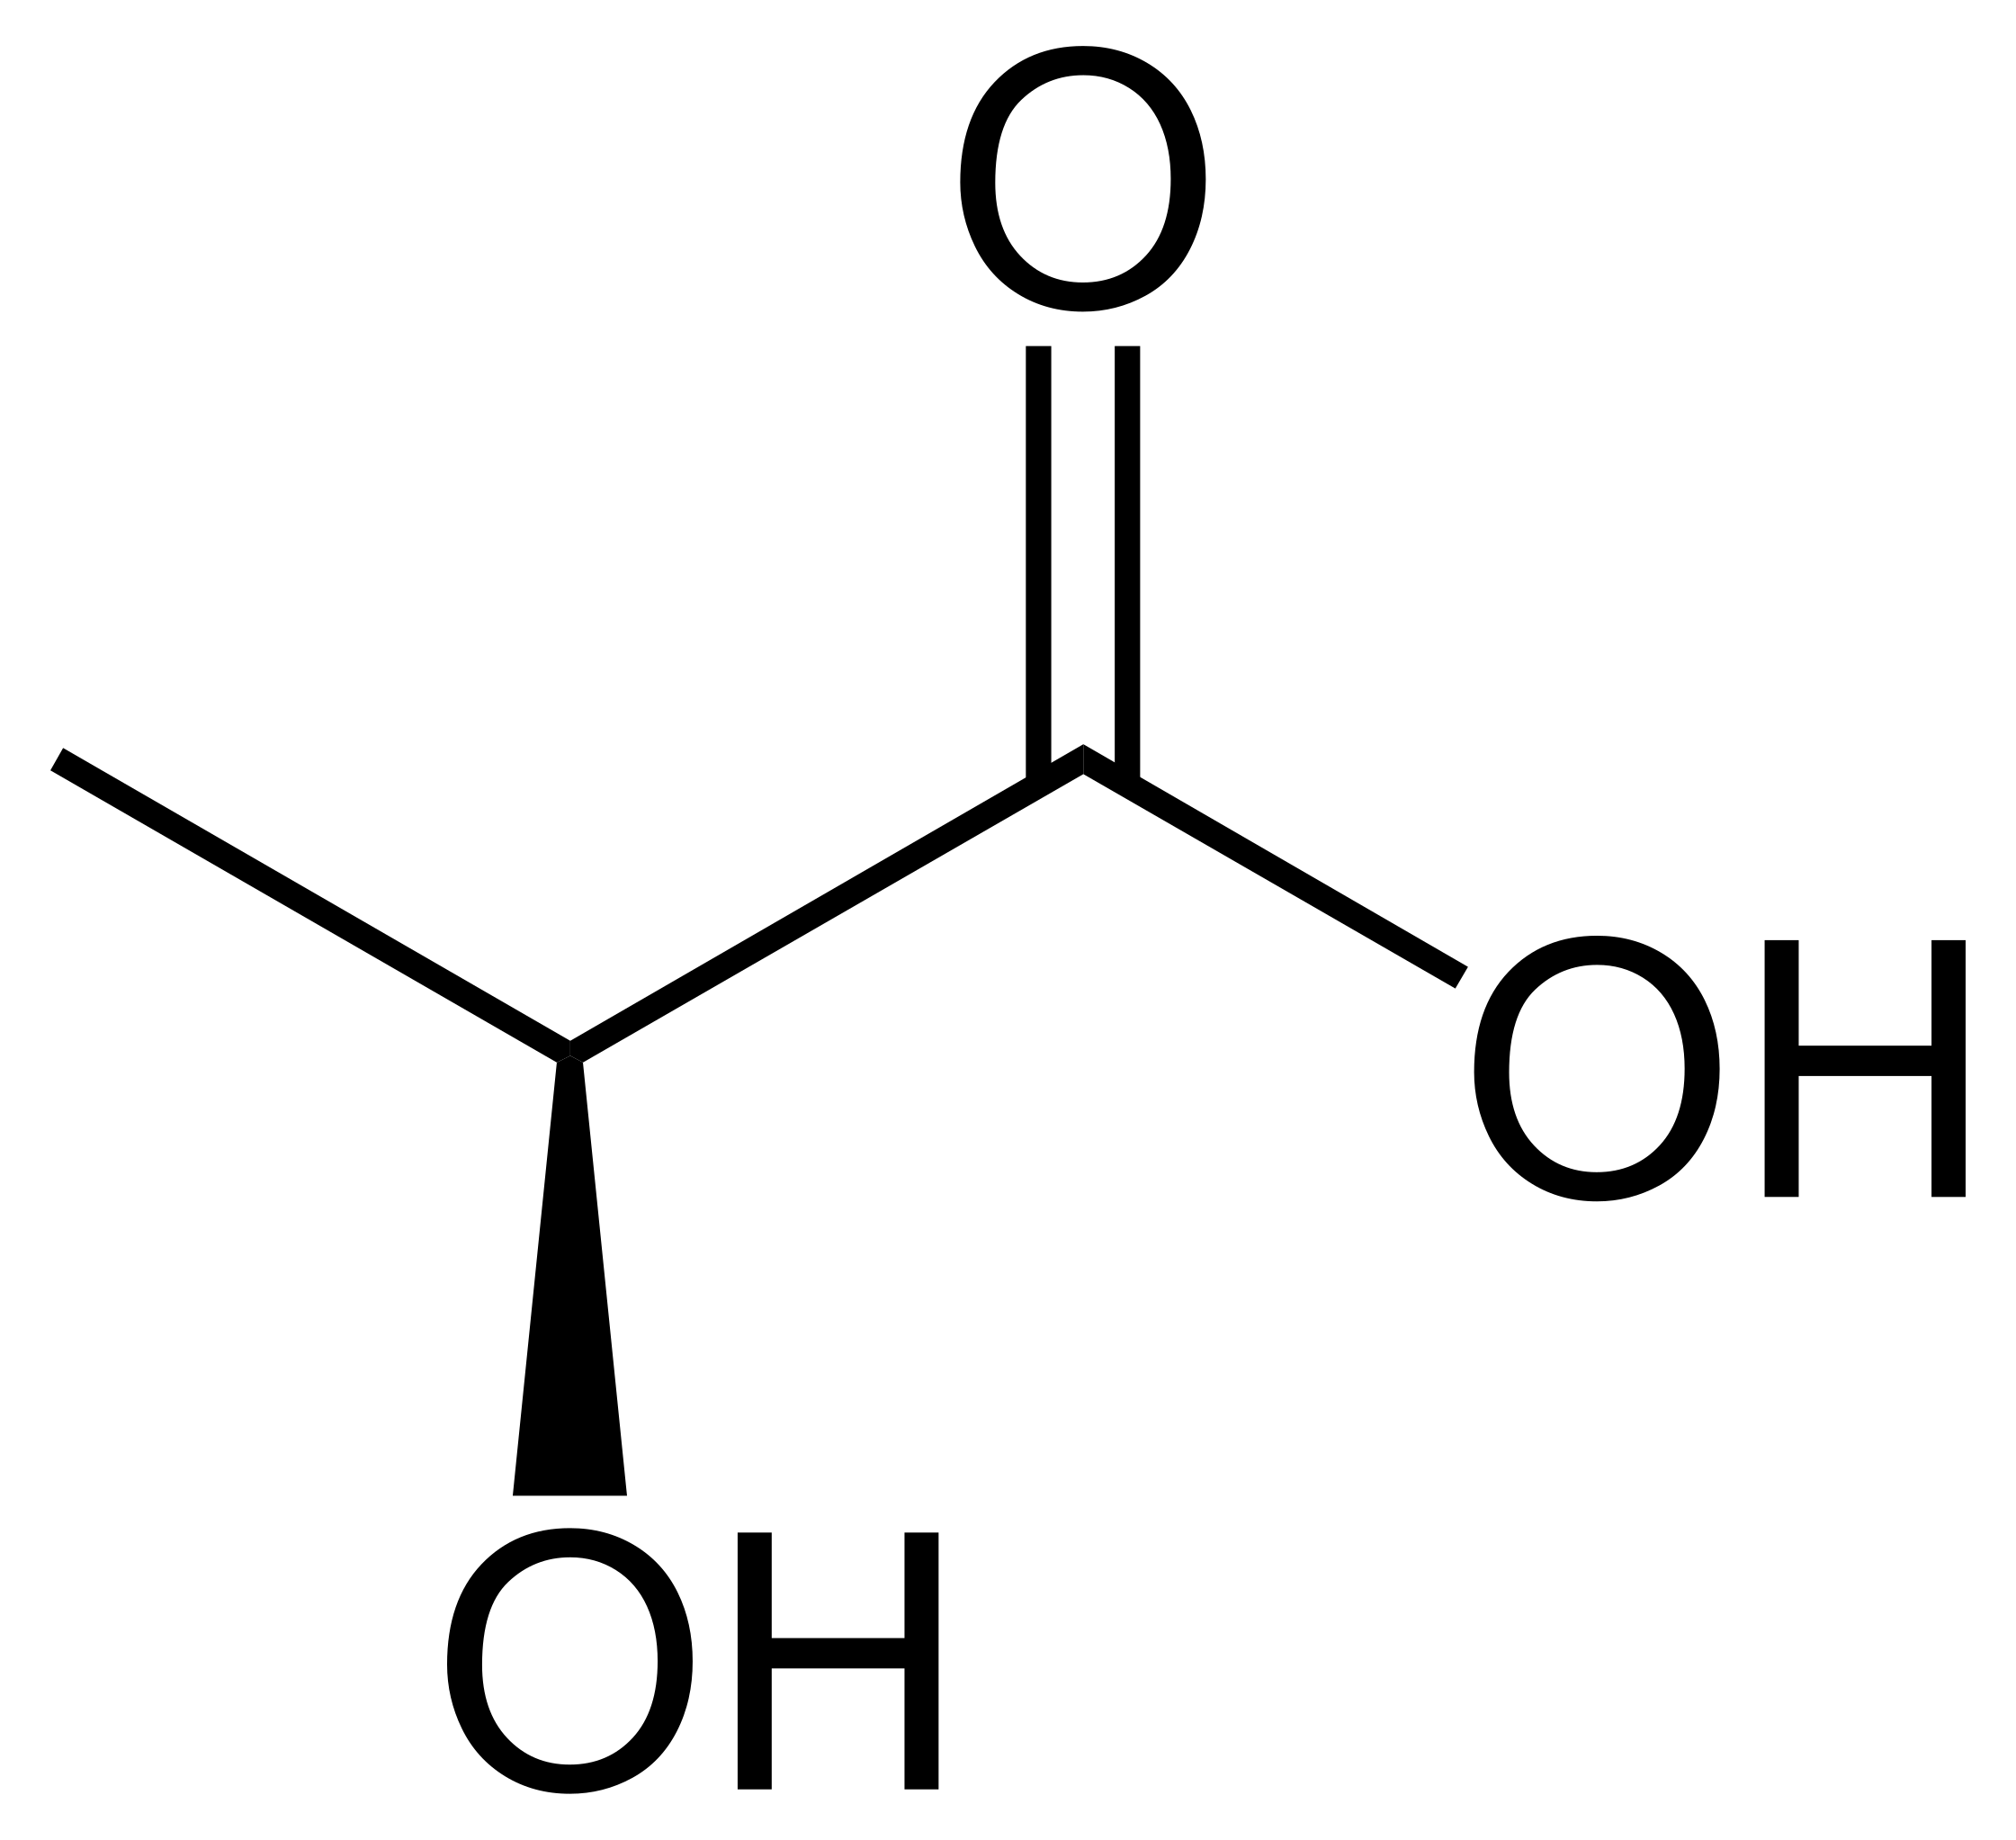
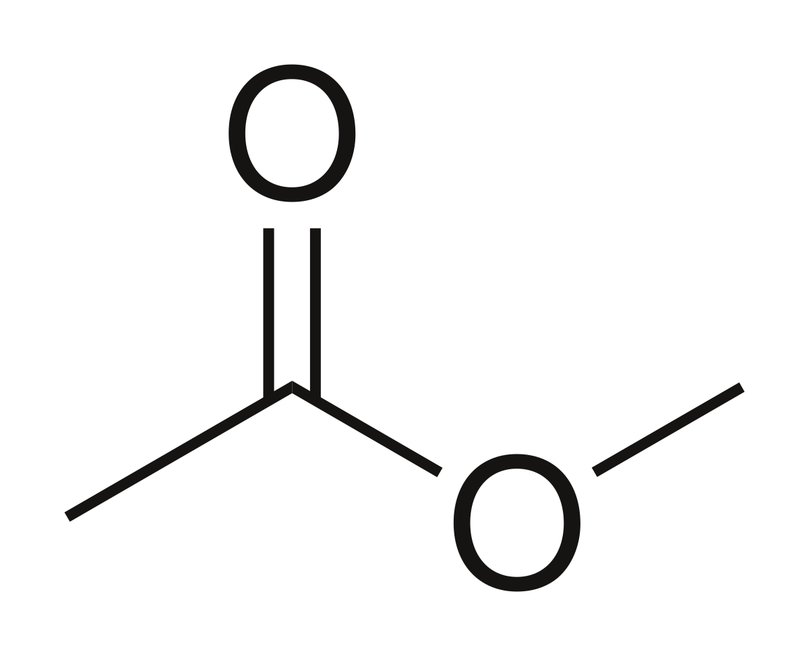

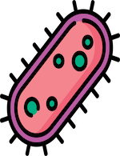
Bacteria Biology
0.2-2.0 μm Diameter, 2-8 μm Length
Bacterial Infections
Environment and Resource Turnover
Break Food Down
Notes:
This is how a phage looks like, this is how they work, the life cycle, then this is a real life result.
So phases are small viruses that contain different building parts so there is the captured which contains the DNA strand, there is a tube as well as a base plate and fiber that detects the bacteria cell upon detection in the phases, inject their DNA into the bacteria cell, and the page can either enter the lysogenic cycle, analytic cycle. In the lysogenic cycle, the page integrate itself into the hosts DNA and replicates along with it as the cell replicate then upon a signal, say cell damage, the page can leave the lysogenic cycle and enter the lit cycle, where it takes over the hosts replication machinery and creates copies of itself. Eventually in the faith will chemically burst the cell wall and release all the nutrients and phages into environment to infect other bacteria.

Slide 3



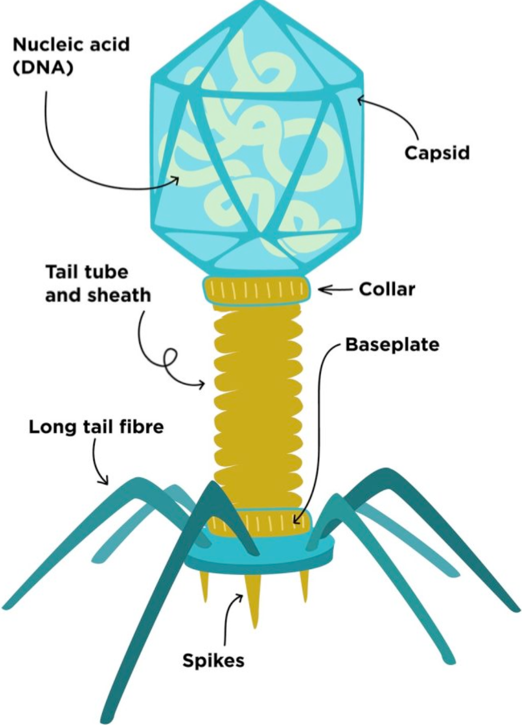
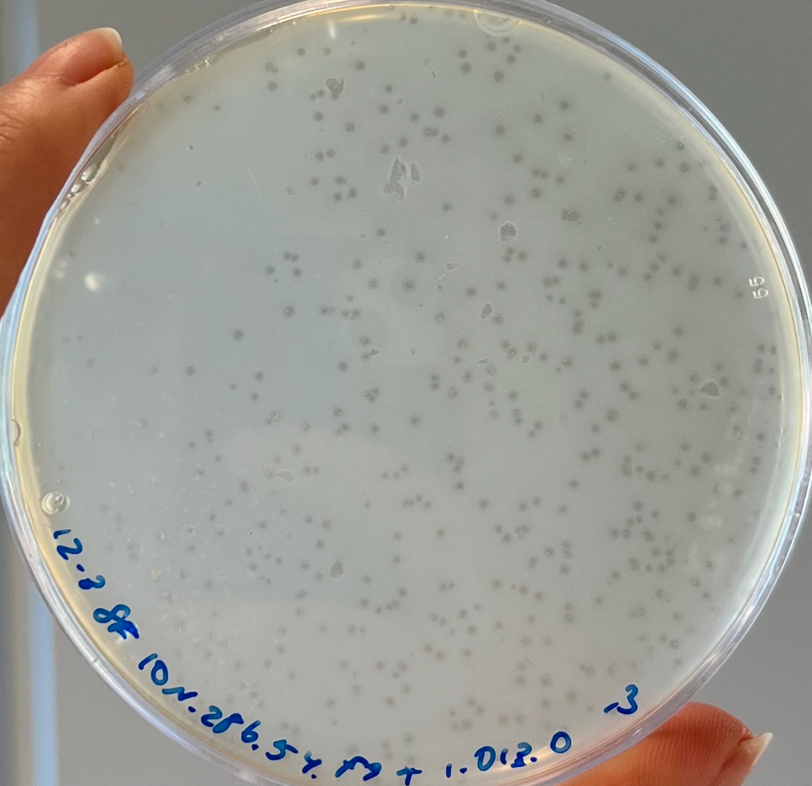
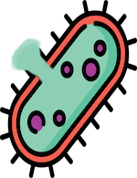
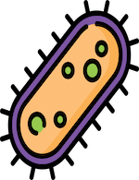
Phage Biology
Detection
Cell Death
Infection
27-190 nm
Replication
Phage Plaques
Phage Lytic Cycle
Notes:
This is how a phage looks like, this is how they work, the life cycle, then this is a real life result.
So phases are small viruses that contain different building parts so there is the captured which contains the DNA strand, there is a tube as well as a base plate and fiber that detects the bacteria cell upon detection in the phases, inject their DNA into the bacteria cell, and the page can either enter the lysogenic cycle, analytic cycle. In the lysogenic cycle, the page integrate itself into the hosts DNA and replicates along with it as the cell replicate then upon a signal, say cell damage, the page can leave the lysogenic cycle and enter the lit cycle, where it takes over the hosts replication machinery and creates copies of itself. Eventually in the faith will chemically burst the cell wall and release all the nutrients and phages into environment to infect other bacteria.

Slide 4





30%
Daily marine bacteria death due to phages
Important role in nutrient turnover
Change bacteria population fitness
Phages can fight bacterial infections and foodborne illnesses
Notes:
Give introduction to what I am studying, why I am studying, implications of what I am studying. So about 30% of daily marine bacteria, death is caused by phages. It’s really important to understand pages and bacteria in a complex system because bacteria are when the driving force is behind evolution and nutrient turnover. Bacteria have huge impacts on the environment, as well as on human health. Bacteria are used to breakdown food in the gut, but they can also infect humans.Bacteria also have an important role in environment by recycling resources, Cyanobacteria create oxygen, but too much cyanobacteria cause toxic blooms.
Phages can be used to control foodborne illnesses, or fight bacterial infections.

Slide 5





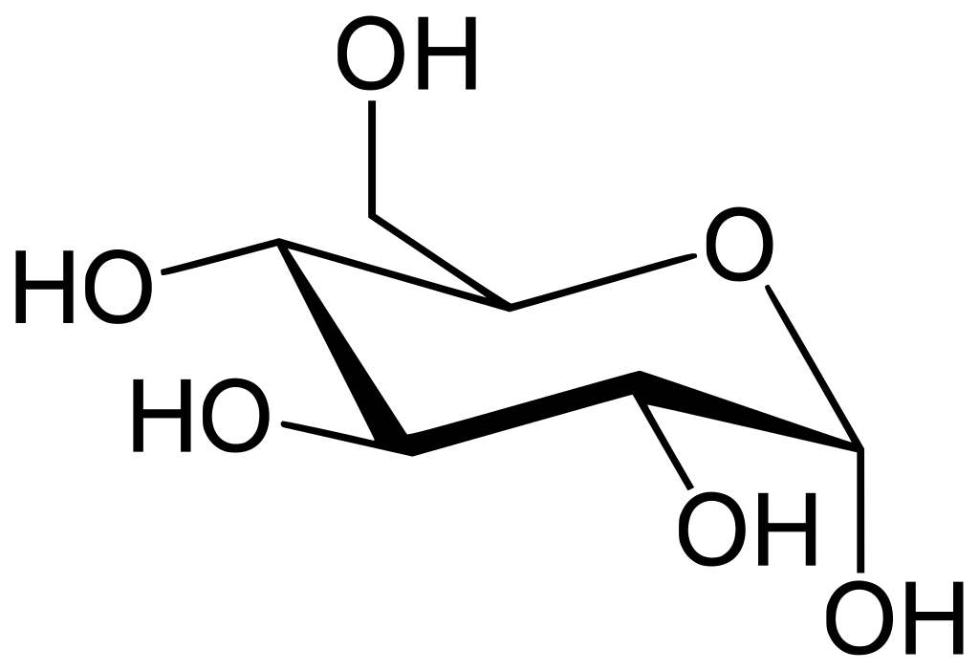
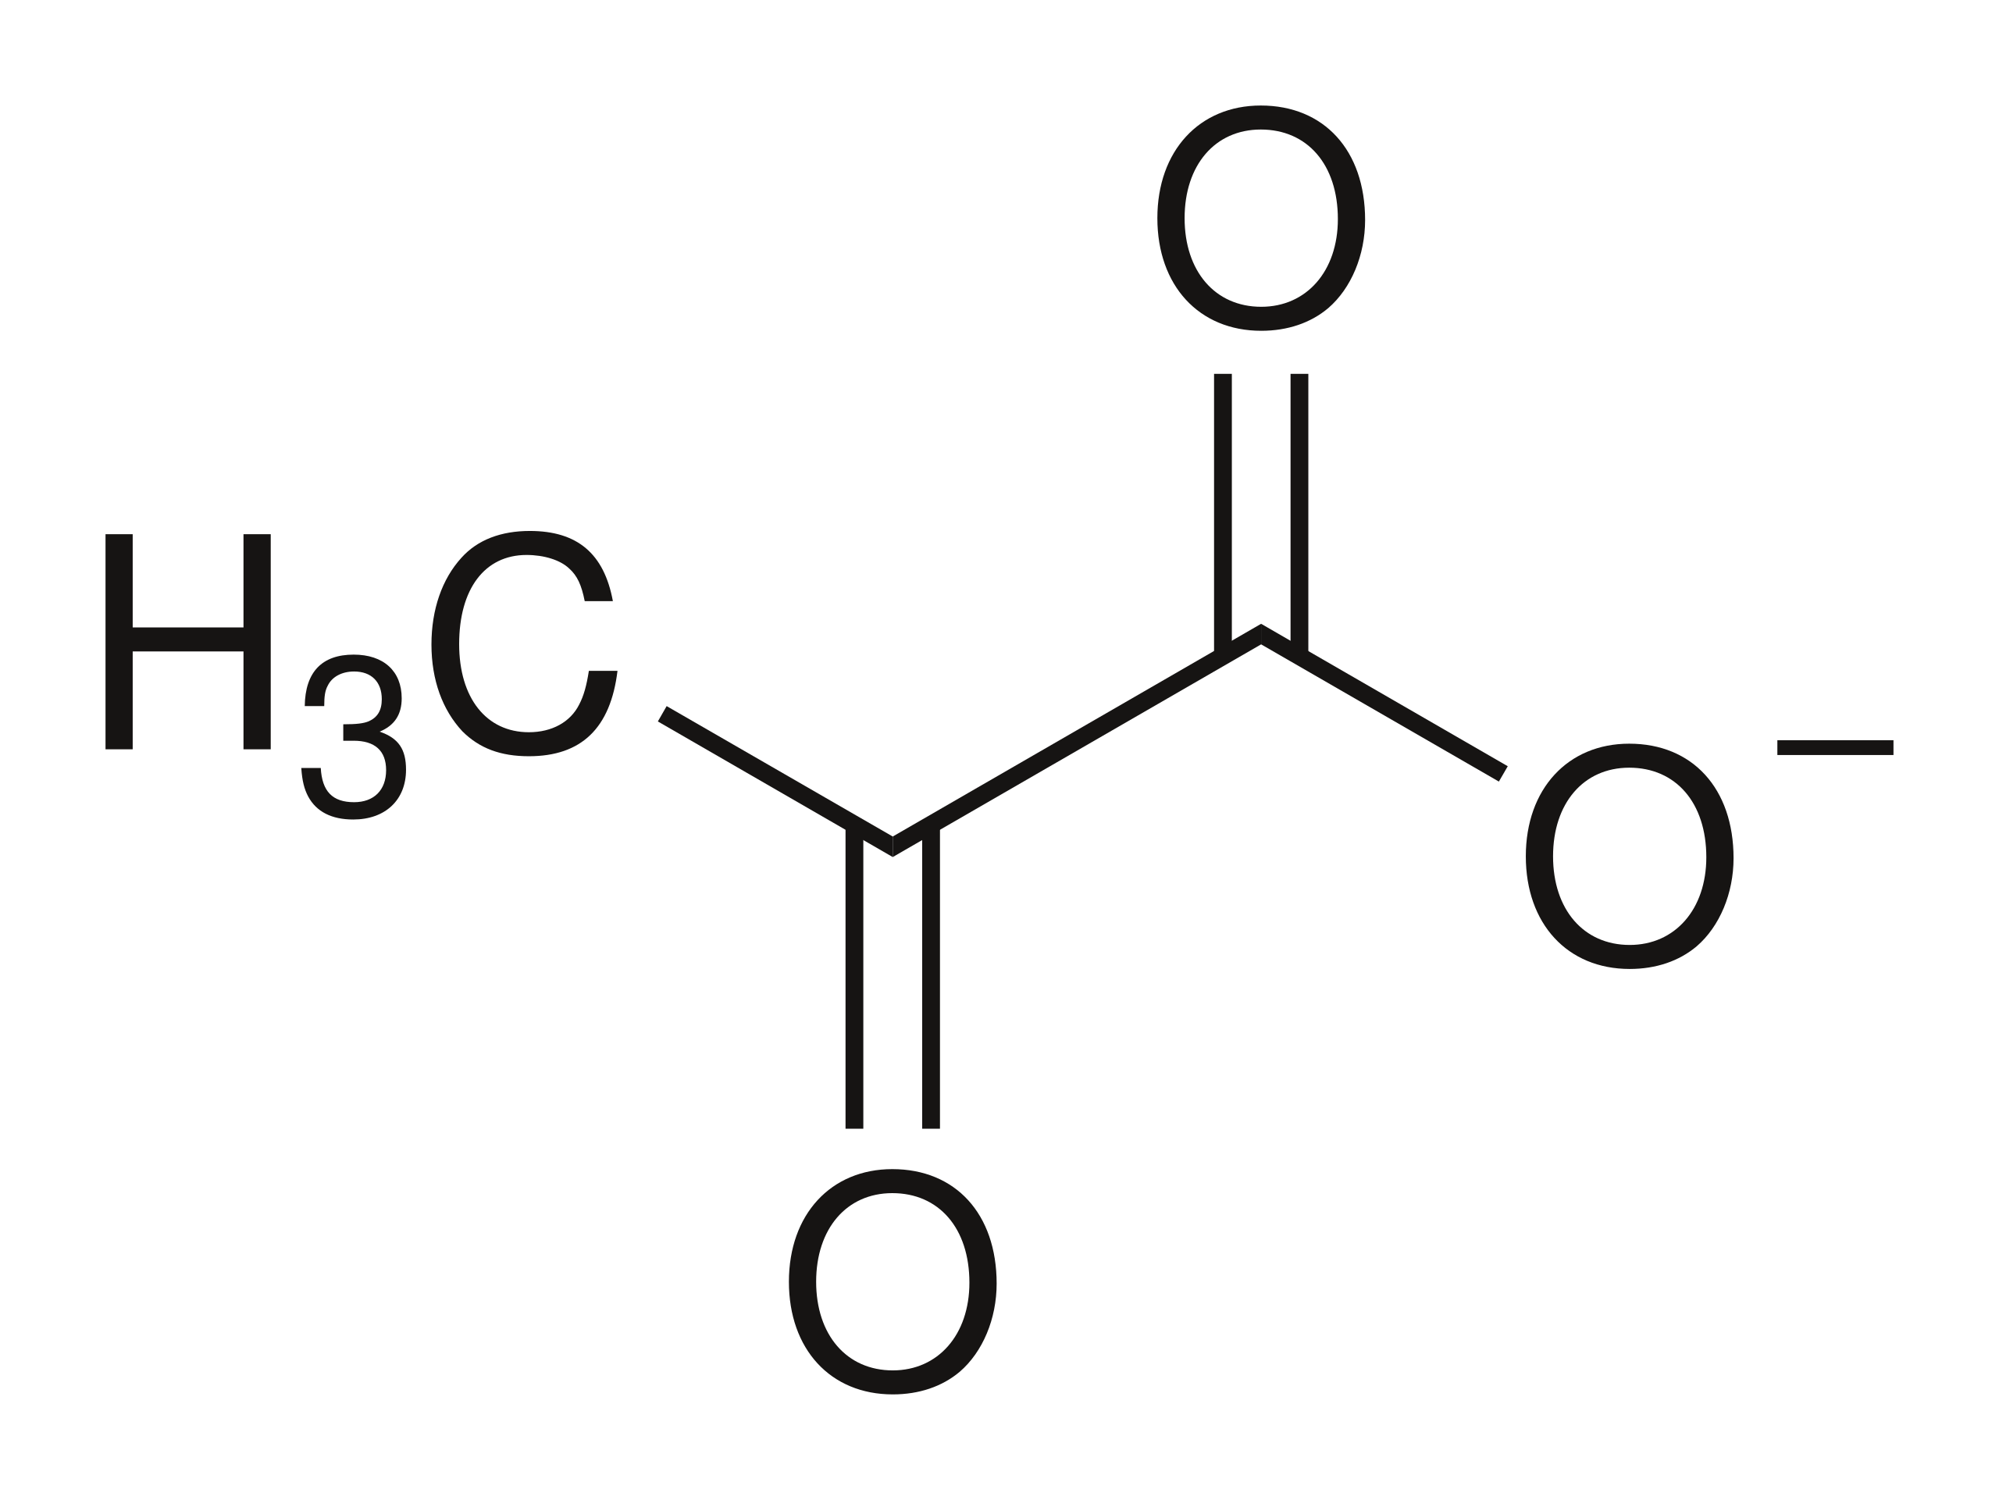


Problem
x100
Notes:
So what is the current problem with modeling large microbial communities well there sometimes hundreds of different bacteria and pages and resources they’re all in tracking with one another very strengths and different population sizes and some will some bacteria require a certain resource that another bacteria doesn’t sometimes the bacteria they interact with other bacteria and there is also external influences. For example, there are washing washout resources, which involve harsh chemicals with varying pH levels and acidity, as well as UV damage that can affect bacteria and phages, along with temperature fluctuations.

Slide 6



Challenge
Current models focus on small systems
Niche or specific situations
Limited flexibility in model setup
Varying or unknown model and input
Notes:
The challenge regarding model is the systems is that current model is explicitly focused on one page and one bacteria interactions for two phages infecting one bacteria, some models that have designed are very niche and the software that’s been built to model. Those interactions are very niche. There’s then limited flexibility in the model set up and you don’t know the model structure and the input until the user wants to use it.

Slide 7

Answer
Flexible simulation framework
Network representation
Model each state and interaction
Unique parameter values
Interactive dashboard
Easy to setup
Notes:
So the answer to this problem and these challenges is to create flexible, simulation framework that takes a network representation of the interactions, model of each individual state of the system and there’s an interactive dashboard and it’s easy to set up where a bachelor student or someone with low coding skills would be able to set up the program

Slide 8


RQ1 led to RQ2
RQ1
RQ2
RQ2 can be used to answer RQ1
Proposed by Matti: How do phages impact community dynamics in complex microbial communities?
Proposed by me: How can you effectively model and interact with any p phage, b bacteria, and r resource (pxbxr) system?
RQ2 is the main RQ
Briefly cover RQ1
Notes:
I will be presenting about mathematically modeling the interactions between phages, bacteria, resources, and environment. I'll be covering two research questions. The first research question is how do phases impact community dynamics and complex micro communities. I use the first research question to come up with the second research question which is how can you effectively model and interact with any PBR system and using research question to answer research question one.
This report is less about finding new biology on phages, or inventing new research, or gaining more knowledge on dynamics, but more about creating a tool that can allow others to do the research with their own ODEs and parameter data. My background is in computer science and not biology so I approach for more of a holistic view rather than trying to really understand the system and trying to gain new knowledge from the system.
I will later demo the tool I created, and show some more advanced graphs that can be created using the tool.

Slide 9


PHAGE AND BACTERIA MODELS
Notes:
Now I’ll be discussing basic page biology as well as some ODE models

Slide 10
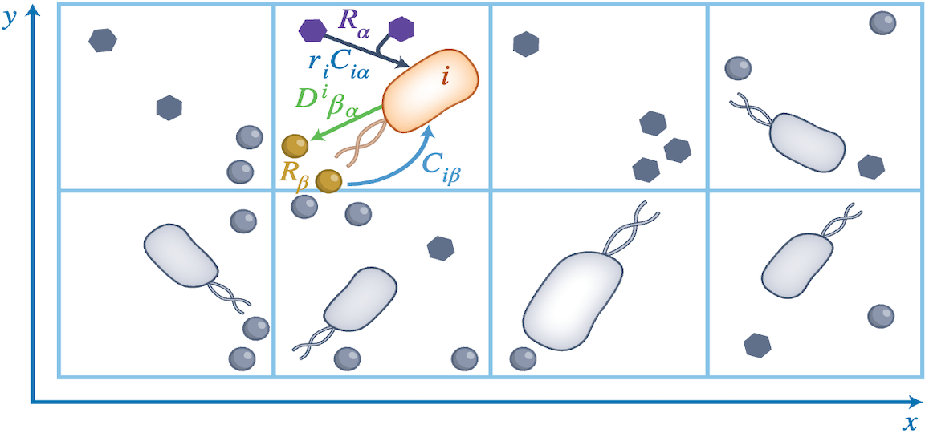
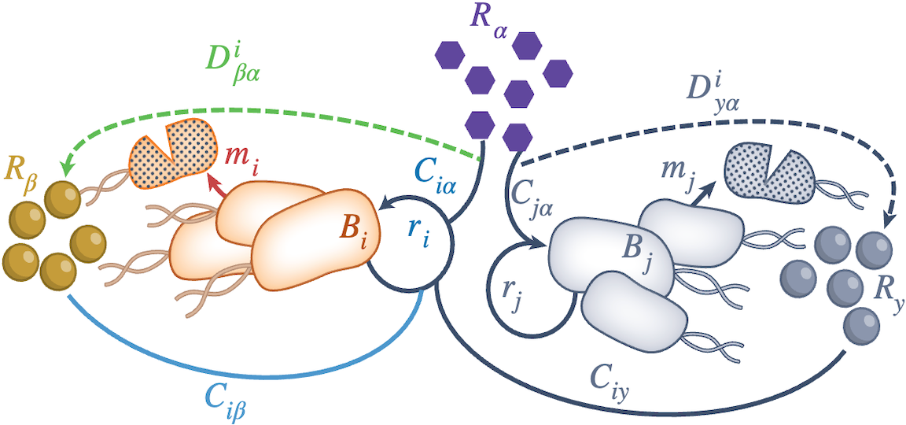
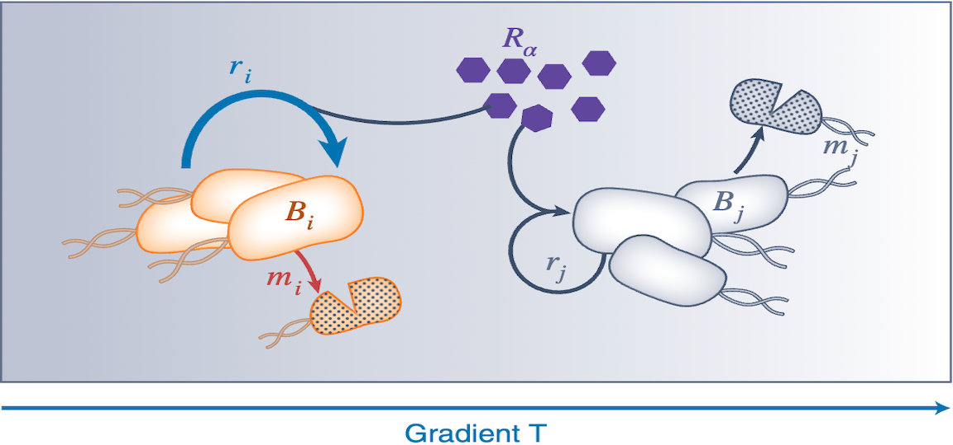
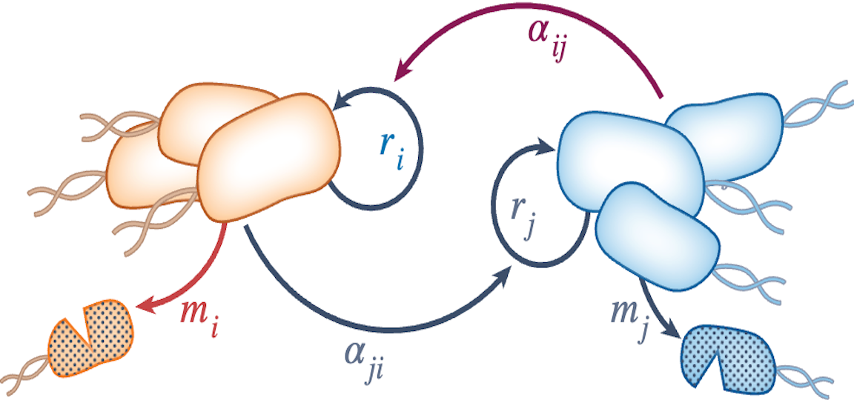
Different Models
Agent Based Model
Consumer-Resource Model
Spatial vs. Non-Spatial Models
Explicit vs. Implicit Resource Consumption
Individual vs. Population Based
Spatial, Explicit, Individual
Non-Spatial, Explicit, Population
Trait-based (PDE) Model
Lotka-Volterra Model
Spatial, Explicit, Population
Non-Spatial, Implicit, Population
Notes:
There are different kinds of models, for example there’s an agent based model, there is a consumer resource model, a trait based PDE model and a lotter model and you can really see these models on a 3D dimension.
So you have a spatial verse non-special models, explicit input, resource consumption, models and individual versus population based models so an agent based model would be spatial resource, explicit and individual while consumer resource non-spatial explicit population model trade base model is in their spatial resource, explicit and population and Catera models are non-spatial resource implicit and population.
Spatial models mean that models no work each entity is at a certain time. Explicit resources models model resource consumption, while individual based models model each individual entity compared to a population model that models whole populaoitn counts.

Slide 11
General ODE Structure
Resources = – consumed + washin* – washout*
Uninfected Bacteria = grow – infected – washout*
Infected bacteria = infected – die – washout*
Phages = burst – adsorbed – washout*
Bacteria consume resources (or grow)
Washin and washout
Bacteria become infected
Bacteria go through an infection process
Bacteria release phages
Phages adsorb to bacteria
* = optional/extra
Notes:
So the general page back to your resource ODM structure looks as followers resources are being consumed, and there’s an optional terms that you can add where upon a bacteria resources are added back to the system, and there can be a washing and wash out of the resources and the unaffected factor and they grow they become infected, and they become they go to infected stage along with a wash out the infect come from the infected bacteria to the infected bacteria stage, and they can go through an infection stage where they go through multiple stages eventually they die along with the washout in the pages. They burst and create new phases, as well as they are as well as being absorbed to the unaffected bacteria along with the washout.

Slide 12
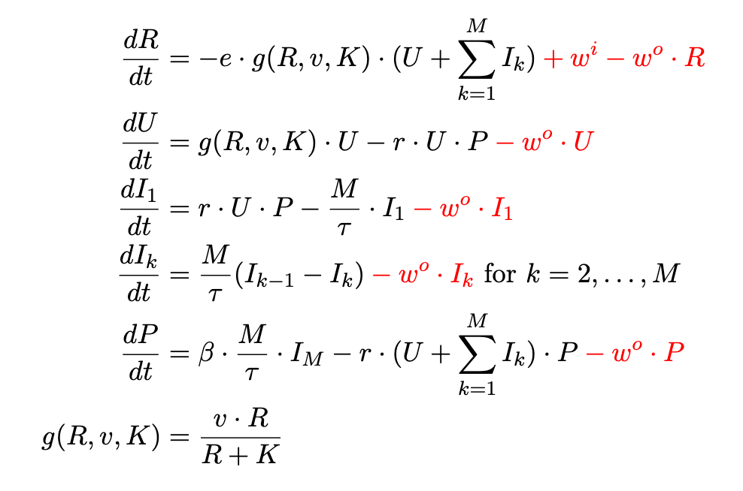


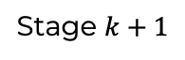
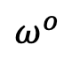
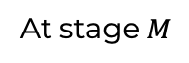
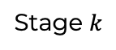
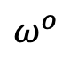
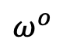
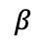
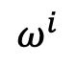
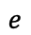
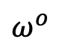
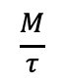
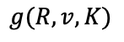
Golding Model
$$ω^{i}$$
Bacteria consume resources (or grow)
Washin and washout
Bacteria become infected
Bacteria go through an infection process
Bacteria release phages
Phages adsorb to bacteria
$$e$$
$$ω^{o}$$
$$g(R, v, K)$$
$$ω^{o}$$
$$r$$
$$ω^{o}$$
Stage $k$
$$\frac{M}{τ}$$
Stage $k+1$
$$ω^{o}$$
$$β$$
At stage $M$
Notes:
The gold model which I use throughout my thesis as well as what I’ll be using for this presentation. Bacteria the grow and become infected as well as washed out the infected bacteria go to infected stage one where the bacteria go from stage one to stage two to stage 32 stage M or number of stages that there are as well as being washed out the pages, and they grow once the infected bacteria has reached staged them, as well as being absorbed to the unaffected bacteria with rate R and the resources they are consumed at a rate E proportional to the number of infected and infected bacteria as well as the washout rate and the bacteria they grow at a Menard equation rate.

Slide 13

SIMULATION FRAMEWORK AND TOOL

Slide 14
Framework Flowchart
Notes:
So here is the framework flow chart, where the user crates and ODE model and a network using the tool and the importance of the ODE solver and use the dashboard tool to interact with the visualization and create visualization and interact with solver.

Slide 15
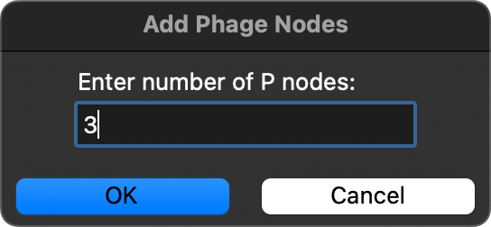
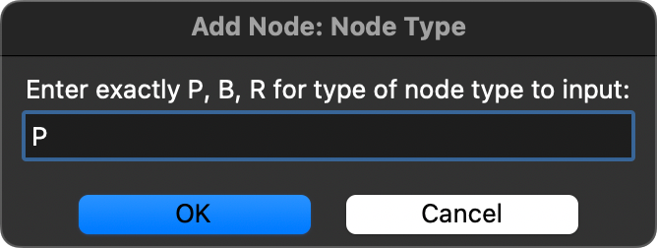

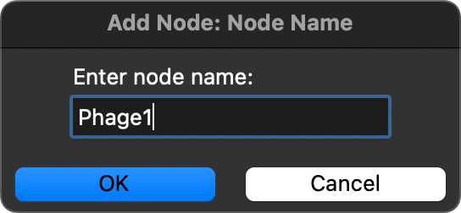
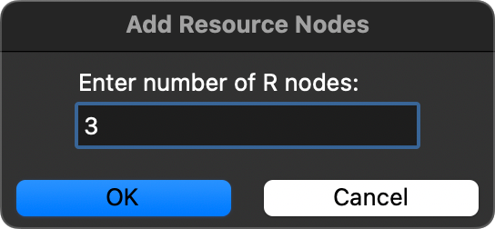
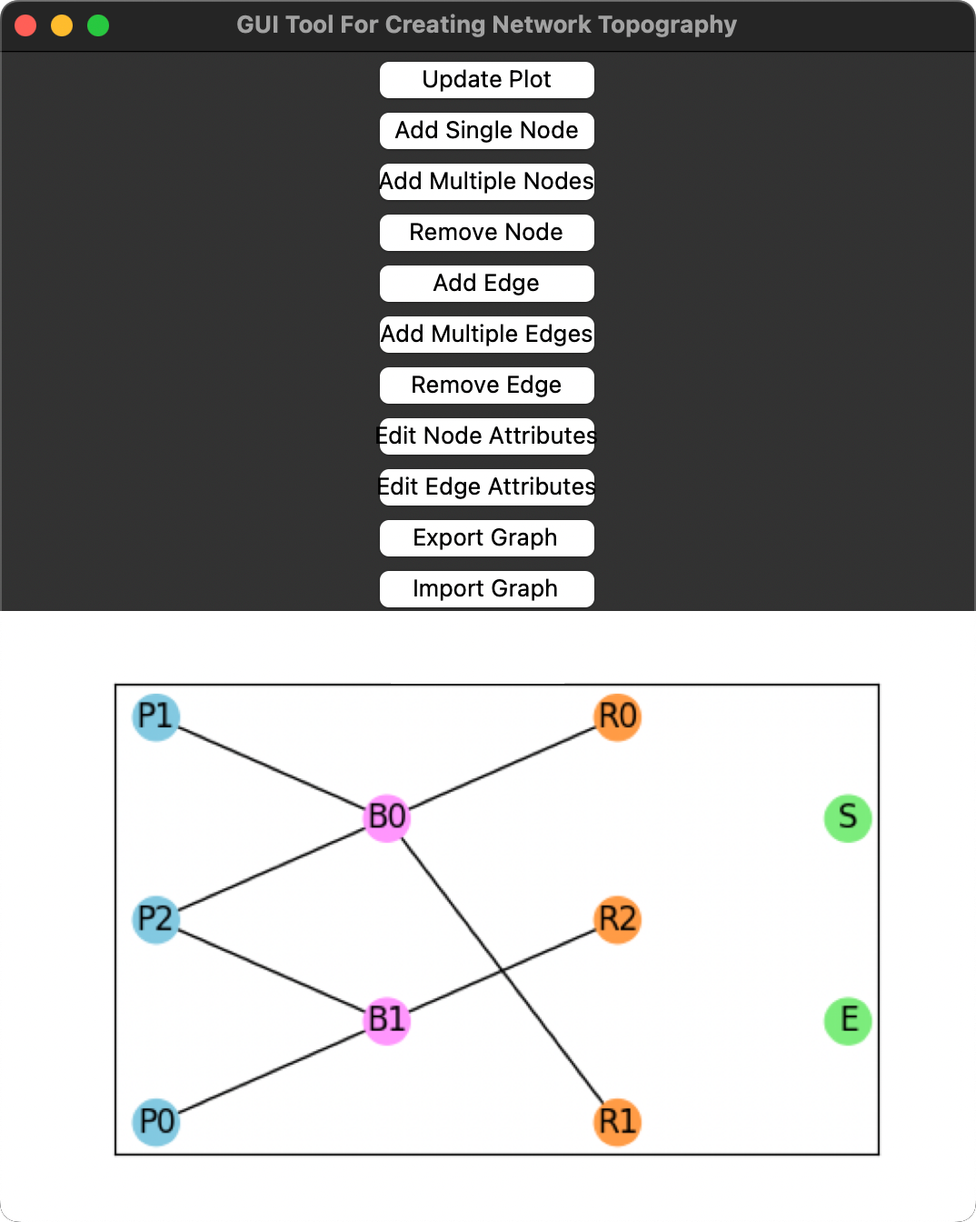
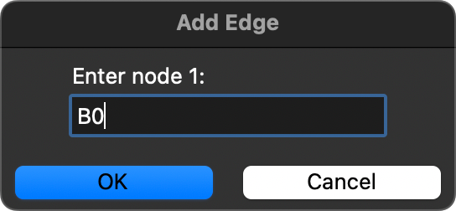
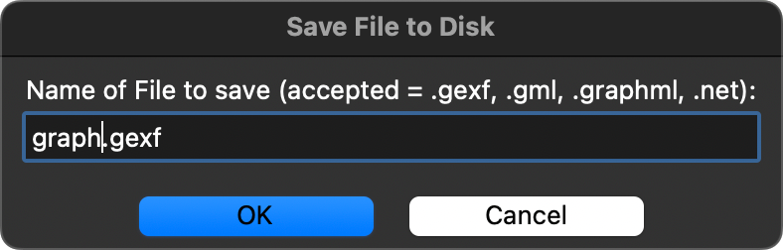
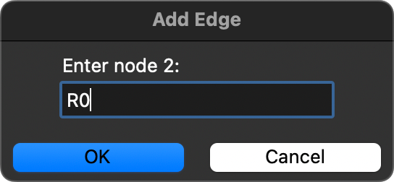
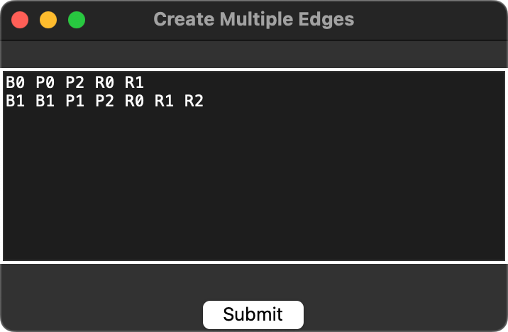
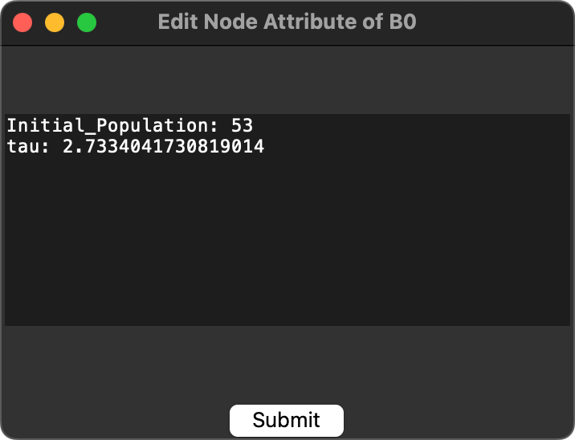
GUI Tool
Notes:
The GUI tool, which is used to create the network has different functionality, for example adding those removing nodes, adding the node attributes and editing the edge attributes.

Slide 16
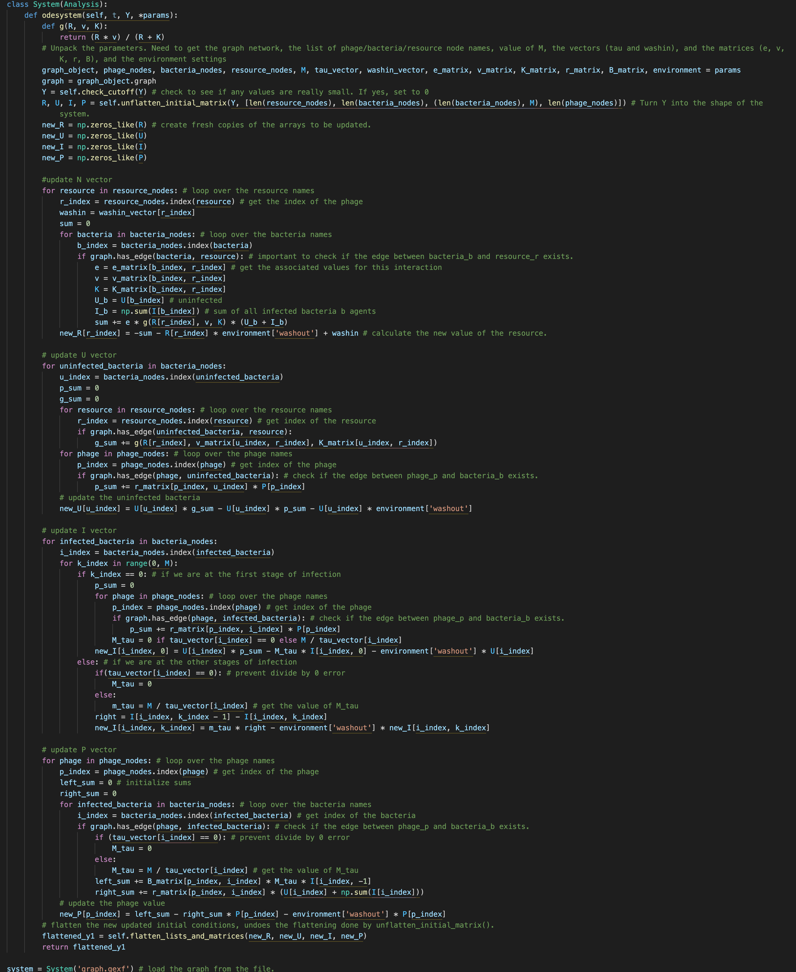
ODE Code
Build ODE programmatically
Loop over nodes and edges
Notes:
So typical models they hardcode the OGE equation, but here I approach it programmatically where you create the OTE equation by looping over the different notes so the pages in the bacterial notes and you check to see if there is edge between a bacteria and a stage and then if there is a new update in the summons of the OD equation in or new updated value. It’s simple to add new parameters at the top. You just add a new perimeter and then later the code you use the parameter.

Slide 17
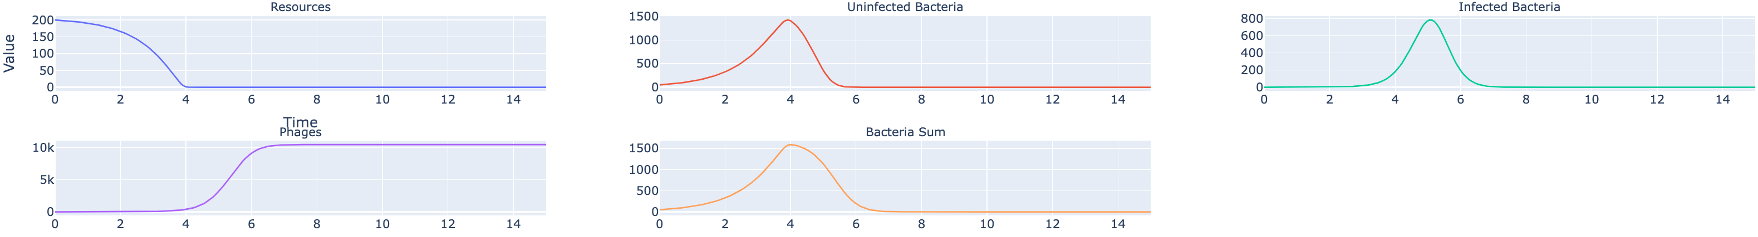
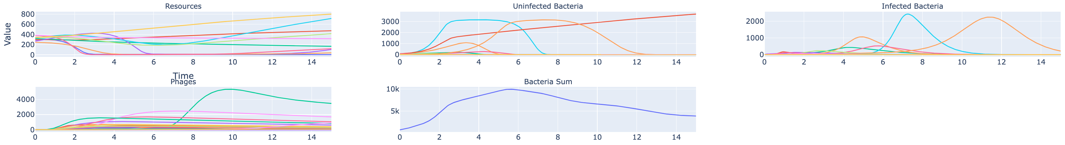
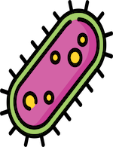
Dashboard – Basic Graph
Notes:
When you open up the dashboard, this is the first plot that you see so you can see how the different resource infected and infected bacteria, phases, and bacteria. Somehow they all grow overtime using cereal, transfers and if you run zero transfers, and then you can see how the distribution of the end values at the end of each seal transfer changes overtime.

Slide 18
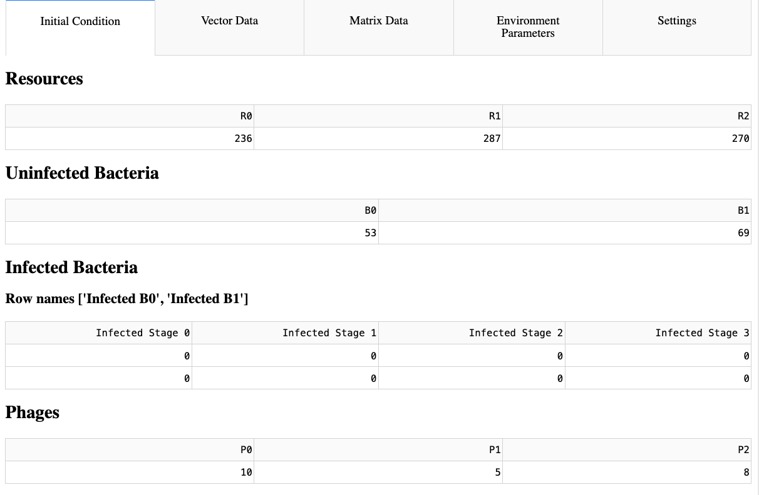
Dashboard – Edit Parameters
Notes:
On the dashboard, you can edit the parameters so here in the initial condition, you can edit the initial resource infected, infected in age parameters

Slide 19
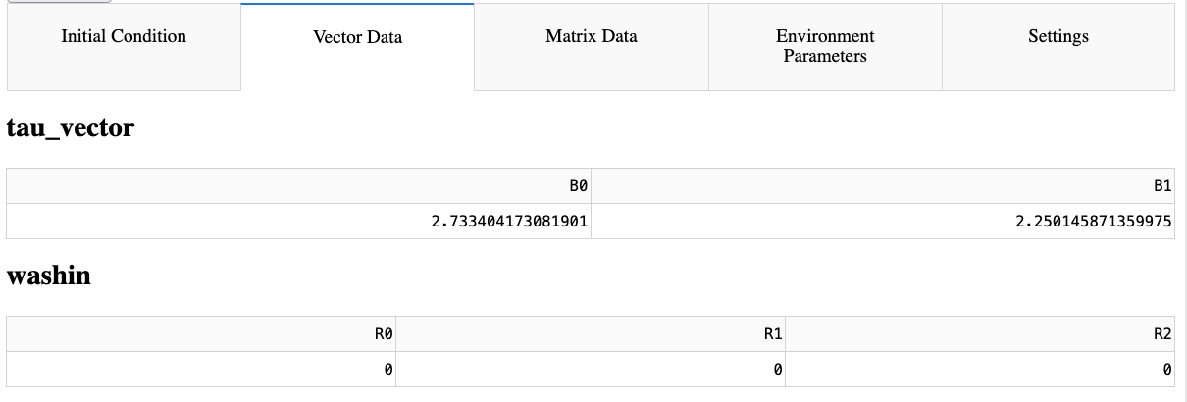



Other Editable Sections
Notes:
There are other editable sections for example of the vector data, matrix data environment parameters, and settings, so the vector data covers data that be stored on a node for example how long it takes for a bacteria to go through the lit cycle matrix state would be data that stored on the edge for example how well of bacteria consumes a resource in the environment program that’s more for holding environment, data such as temperature and pH or the washout rate while the setting page is more technical change the simulation length of time tolerances in max step size

Slide 20

Dashboard – Advanced Analysis Initial Value Analysis
Notes:
There are other analysis for example initial value analysis or change value, and you see how it change in the forever value affects the growth or the curve of the line

Slide 21





Other Advanced Analyses
Notes:
Their other analyses that you can use, for example whether there’s cereal transfer that I showed earlier and there’s primary analysis where you change two parameters and you get a heat map of the population time at that time and there’s a slider they can change to show the values at that point in time there is a face portrait which compares the population the gro respect to another population growth. There is soul analysis. Sobel is then used to measure how to change in a perimeter input affects the output of a univariate variable like the max time or the value or the time at which the population peaked in the last part is ultimate analysis where you can define your own simulations run it download the data and create your own analysis.

Slide 22
Dashboard – Interactivity
Interactivity comes first
Selectable dropdowns
Change axis-scale
Zoom in/out
Hover over elements
Change parameter values and settings
And more
Notes:
So when I was creating the dashboard interactivity, interactivity was at the forefront of my design choices so interactive comes first where I can select drop-down to change prayer value you can zoom in and zoom out you can change axis scale you can run transfers you can change printer values you can iterate over range or a specific set of perimeter. Values in every element and graph is hover bowl and shows the perimeter conditions and you can compare values and allows greater understanding of system where you can interact with it and change the values in the simulation.

Slide 23


Dashboard – Interactivity
Notes:
So there are different activities that you can use in the dashboard, for example, you can hover over a line and you can see at the population valley at that time or in the case of a linear regression curve. You can see the slope and intercept R squared value.

Slide 24




Other Interactivity
Notes:
And their other interactive, so you can change the range of parameter values to test, as well as if you want to use a cereal transfer in the program, you can change the white axis scale from linear to logarithmic and you can also compare values in the case of when you run multiple initial values one after now that you can compare the linear regression values.

Slide 25
EXAMPLE USE CASES
Notes:
Now I’ll be talking about the results that I use that I got from the dashboard

Slide 26



01
02
PARAMETER SENSITIVITY
CHANGING INITIAL CONDITIONS
04
EXTENDING TO A LARGE 20x20x10 SYSTEM
03
CONDITIONS FOR PHAGE PROLIFERATION
Notes:
So first I’ll we talked about the Sobel sincerity analysis as well as the initial value analysis I’ll do page proliferation analysis and a 20 x 20 x 10 viability matrix, where the data has been downloaded directly from the dashboard

Slide 27
PARAMETER SENSITIVITY
Notes:
Now I’ll be talking about the results that I use that I got from the dashboard

Slide 28
Graph Behavior – Anecdotal POV
$τ=0.5$ (fast latent time)
$τ=3$(slow latent time)
Conclusion: “As I increase tau, the latent period increases, which means it takes longer for the phages to burst, so more bacteria grow before …”
How to do this systematically?
Many parameters, which ones are important? Why 𝜏?
Notes:
Graph behavior from an anecdotal point of view would be varying a primary value and seeing how it changes as a change per value so if you change the latent period time for infection, DSU decreased towel on the page. The page is peak earlier and higher. The more phases are created well if you increase tell so it’s a slow time and then you get less stages that peak later time but you get more total bacteria.

Slide 29



Graph Behavior – Systematic POV
Final Value
Peak Value
Time of Peak Value
Resources
Phages
Total Bacteria
“I don’t know what happens if I increase tau (or why), but I see that it dramatically affects the phage peak value, likewise for …”
Notes:
If you do it from a systematic point of view, Soble, you see that over a wide range of values. The town value has a great effect on the time of peak value for the pages, but doesn’t really affect the peak value or the final value as much, but the value will greatly affect the total number of the maximum amount of bacteria in the system and from a systematic point of you you don’t know what happens if increased towel or why but you see that it affects the fat

Slide 30
Anecdotal POV + Systematic POV =
Greater Understanding Than Just Individually!
Notes:
If you combine the two, then you get a greater understanding and then just seeing it from one point of view

Slide 31


Combined Understanding
Tau = 0.5 (faster latent time)
Tau = 3 (slower latent time)
“I see that tau does not significantly affect phage peak value, but rather the time of peak. I know this because tau mainly affects the time to burst, so more phages are created earlier, causing a faster rise in population growth, which …”
Notes:
So when you combine them, then you can see that Faye is that tower is really important to the page peak time the time of the peak I can see that’s important for the absolute peak and total bacteria, but less important for the final value of the pages and then you can see by changing individually he will change the graph so using sobol you can understand which prayers are important and which are not

Slide 32



Sobol – Most Important Parameters
Notes:
So using a full so analysis, you can see that towel the late time or the absorption rate of phages to bacteria and the bitter value, which is in first size those are really important in determining the page final value peak value, as well as the time of peak for the total bacteria everything is kind of important but towel and beta is in general more important for understanding the final value and the peak value and time peak value

Slide 33
CHANGING INITIAL CONDITIONS
Notes:
Now I’ll be talking about the results that I use that I got from the dashboard

Slide 34




Find Regions of Interest
Regime of interest
Notes:
If you go to the initial value analysis, you can see how changing the initial unaffected bacteria affects the stage growth and also the bacteria some

Slide 35
CONDITIONS FOR PHAGE PROLIFERATION
Notes:
Now I’ll be talking about the results that I use that I got from the dashboard

Slide 36

Phage Proliferation*
*Phage proliferation means reached at least 2 times initial starting population
Notes:
Using the ultimate analysis tool, you can change the initial resource and initial page value, and you can run the analysis to see it. What conditions pages will proliferate or not by proliferate I mean reach at least two times it’s initial value you can see as you change resources that really affects if pages will proliferate well if you change the pages, it’s not as important because the skill is from 24.2 to 25 so resources they have a very important role in determining if phases at skillet at least phases will proliferate or not by how much

Slide 37

Phage Proliferation*
*Phage proliferation means reached at least 2 times initial starting population
Notes:
Using the ultimate analysis tool, you can change the initial resource and initial page value, and you can run the analysis to see it. What conditions pages will proliferate or not by proliferate I mean reach at least two times it’s initial value you can see as you change resources that really affects if pages will proliferate well if you change the pages, it’s not as important because the skill is from 24.2 to 25 so resources they have a very important role in determining if phases at skillet at least phases will proliferate or not by how much

Slide 38

Phage Proliferation*
*Phage proliferation means reached at least 2 times initial starting population
Notes:
Using the ultimate analysis tool, you can change the initial resource and initial page value, and you can run the analysis to see it. What conditions pages will proliferate or not by proliferate I mean reach at least two times it’s initial value you can see as you change resources that really affects if pages will proliferate well if you change the pages, it’s not as important because the skill is from 24.2 to 25 so resources they have a very important role in determining if phases at skillet at least phases will proliferate or not by how much

Slide 39
EXTENDING TO A LARGE 20x20x10 SYSTEM
Notes:
Now I’ll be talking about the results that I use that I got from the dashboard

Slide 40

20x20x10 Survivability* Matrix
*Survived means $≥1$ at end of simulation
Notes:
Here’s a 20 x 20 x 10 survival bill matrix for the phases and infected bacteria where they survived if there is at least one phase or one bacteria that survived until the end of the simulation and by changing the towel and beta value, you can see how the pa survive if Tal Valley is really low and beta Valley is really high, but Beta Valley is really low and the valleys are really high then they don’t survive and likewise, the opposite is true for the unaffected bacteria
50x50=2500 unique simulations, simulation length = 15 time units
20 phages+20 uninfected+20*4 infected+10 resources = 130 unique system states
18GB 12-Core M3 Pro MacBook Pro running simulations in parallel
Slowdown for when $τ>1.5$ , especially for $τ>2.5$ and $τ>3$, 46 min simulation, 23 seconds to create visualization (also done in parallel).
$τ=3.5, β=100$ takes 26.5 seconds to run, while $τ=0.5, β=1$ takes 1.3 seconds. Reason unknown, numerical blowup? 92 mins at slowest vs 4.5 mins at fastest
Confirming by running $τ=0.5−0.6, β=1−10$ 50x50=2500 iterations took 6 minutes

Slide 41
CONCLUSION

Slide 42
Revisiting RQ1 and RQ2
RQ1
RQ2
How do phages impact community dynamics in complex microbial communities?
How can you effectively model and interact with any p phage, b bacteria, r resource (pxbxr) system?
Assists in resource turnover
Inverse survivability relationship
Easy to proliferate, delicate balance
to ensure coexistence
Flexible and powerful framework
User customizability
Parallel computation
Interactive dashboard
Notes:
I will be presenting about mathematically modeling the interactions between phages, bacteria, resources, and environment. I'll be covering two research questions. The first research question is how do phases impact community dynamics and complex micro communities. I use the first research question to come up with the second research question which is how can you effectively model and interact with any PBR system and using research question to answer research question one.
This report is less about finding new biology on phages, or inventing new research, or gaining more knowledge on dynamics, but more about creating a tool that can allow others to do the research with their own ODEs and parameter data. My background is in computer science and not biology so I approach for more of a holistic view rather than trying to really understand the system and trying to gain new knowledge from the system.
I will later demo the tool I created, and show some more advanced graphs that can be created using the tool.

Slide 43







Complex and Unique
Interactive
Flexible
User Friendly
Lab Work
Teaching Tool
Low Code
Notes:
So as conclusion, we saw that in the system is very complex and unique, and each system will be different in how the entities interact with one other the program that created interactive and flexible for different simulation requirements and conditions. It’s very user-friendly as it’s a graphical interface and has applications for a lab work or a researcher might want to use it to compare results as well as make predictions about different conditions. It’s useful for a teaching tool as an introduction to micro communities or introduction to mathematical modeling because it’s low code that a bachelor your bachelor student can use it to play around with model to learn some medical skills and programming skills and sort of see how if I change the lake. How does that affect the bacteria growth?

Slide 44



Next Steps
CODE
LAB
MODEL
Ready to use code samples
New tools and features
For large systems, randomly draw parameter value when changing
Speed optimization
Compare lab data to model data
Create custom ODE model for the lab
Replicate environmental and lab data
Fine-tune model parameters and equation
Compare different model outputs
Adapt or create new models
Notes:
So the next steps first project would be to clean up the code. I provide some samples and get hub, potentially implant new tools and features in the lab. I get to compare lab results to the model and I can create a custom OD model for the lab based on their findings and try to replicate environmental and lab data in the actual model, it finally I would want to find two model parameters equations and compare how different model outputs affect the growth and adapter create new models.

Slide 45
Small GUI And Dashboard Demo*
*if there is time and interest

Slide 46
THANK YOU

